Slide 1


SOFTWARE TESTING (CS-403)
Spree Commerce Storefront End-to-End Test Automation
Highly Maintainable and Data-Driven Playwright Automation Framework
Presenters
Instructor
Date
M. Umer Ahmed Abbasi (22K-4599) Jawwad Ahmed (22K-4648)
Sir Haris Irfan
June 15, 2026

Slide 2


PROJECT OBJECTIVES & GOALS
Core Mission
Key Deliverables
Build a clean, scalable, and modular test automation framework adhering to industry best practices and high design standards.
Automate Journeys: Seamless flow from login to checkout.
Flakiness Control: Smart dynamic wait conditions.
Target: Spree Storefront (React/E-Commerce)
Rich Reporting: Dashboards with traces & screenshots.
Data-Driven: Decoupling data from script logic.

Slide 3
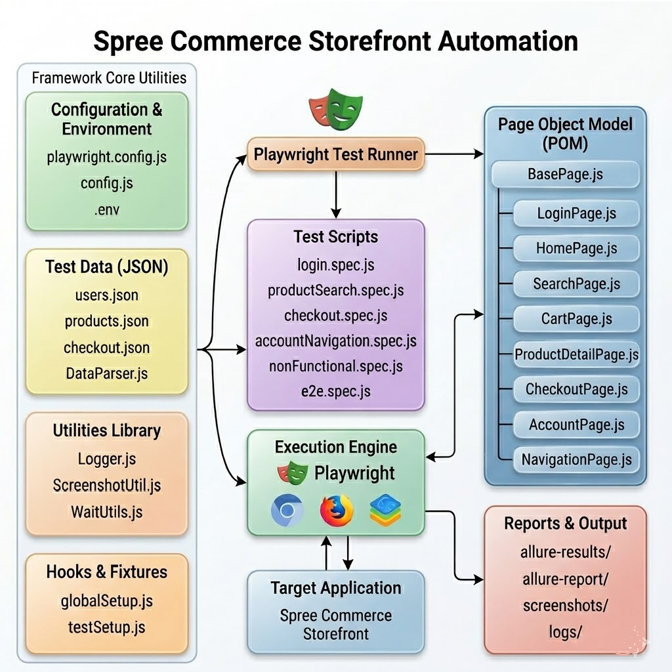


FRAMEWORK ARCHITECTURE OVERVIEW
Separation of Concerns
Inputs & Helpers: Configuration, environment files, JSON test data, and Winston logger utilities.
Execution Flow: Playwright CLI runner executing 43 modular spec scripts efficiently.
POM & Reporting: Page Object Model wrappers for clean interactions and Allure HTML report generation.

Slide 4






DETAILED MODULAR FOLDER STRUCTURE
Core Config
Logic Layer
Utilities
config/ & data/: Environment managers and external JSON datasets (Users, Products, Checkout).
pages/ & fixtures/: Enforcing POM design pattern and dynamic injection of page instances.
utils/ & tests/: 43 spec scripts and helpers for parsing, logging, and smart waiting.
This organization ensures high maintainability and low technical debt across the automation lifecycle.

Slide 5


THE PAGE OBJECT MODEL (POM) LAYER
Inheritance Model
Safe Action Wrappers
BasePage.js: Centralized wrapper for raw Playwright interactions.
Custom methods (click, fill, waitFor) perform actionability checks before execution.
Child Pages: LoginPage, CartPage, etc. inherit from BasePage.
Benefit: Eliminates flakiness by avoiding hardcoded sleep timeouts.

Slide 6
DATA-DRIVEN AUTOMATION STRATEGY
Decoupled Data Logic
JSON Storage: External files for credentials, products, coupons, and forms.
Dynamic Loading: DataParser.js enables running the same script with multiple datasets.
Coverage: Validates both positive and negative functional assertions.

Slide 7






ADVANCED SETUP AND TEARDOWN HOOKS
Custom Fixtures
Global Hooks
Lifecycle Care
testSetup.js auto-injects page instances into tests, removing manual instantiations like 'new LoginPage()'.
globalSetup.js verifies environment readiness and network availability before test suite launch.
beforeEach / afterEach manages cookie clearing, screenshot capturing, and trace log flushing automatically.

Slide 8
COMPREHENSIVE TEST SUITE COVERAGE
Script Category | TC ID Range | Functional Coverage Area
login.spec.js | TC-01 to TC-10 | Authentication, validation, and error handling.
productSearch.spec.js | TC-11 to TC-20 | Search algorithms, suggestions, and cart sync.
checkout.spec.js | TC-21 to TC-30 | Payment rules, shipping forms, and order success.
nonFunctional.spec.js | TC-41 to TC-42 | Responsiveness (Desktop vs Mobile viewports).
e2e.spec.js | TC-43 | Critical Path: End-to-End Customer Journey.
TOTAL: 43 Automated Test Scenarios Implemented

Slide 9
DIAGNOSTICS & LOGGING
Winston Logger: Structured, colorized timestamp logs for terminal and persistent files.
Screenshot Utility: Captures UI state during key checkpoints or failures.
Reporting Link: Dynamic embedding of visual evidence into the test report.

Slide 10




Rich Interactive Reporting
The Allure Report provides a comprehensive HTML dashboard summarizing pass/fail metrics, execution stability, and deep-dive traceability.
Assertion Traceability
Auto-Embedded Screenshots
Performance Metrics

Slide 11
CONCLUSION & FUTURE SCOPE
43
Milestone: Exceeded the 40-case requirement with 100% clean, non-flaky execution.
Robustness: POM structure ensures minimal maintenance for future UI updates.
AUTOMATED SCENARIOS
Future: Integration with GitHub Actions for full CI/CD parallelization.
THANK YOU
Questions? | bcs8a-testing-group

